Slide 1

4
Electric Circuit
4.1
Requirements
4.2
System Flow (Schematic)
4.3
Components
4.4
Electric Circuit
4
Electric Circuit
Mechatronics Project
School of Mechatronics

Slide 2
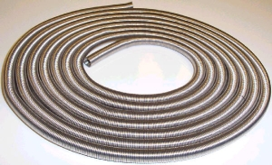
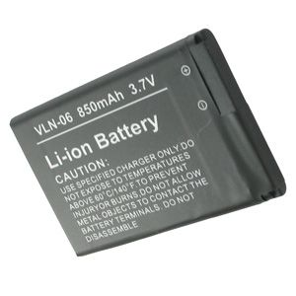
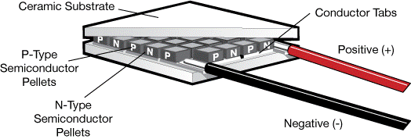
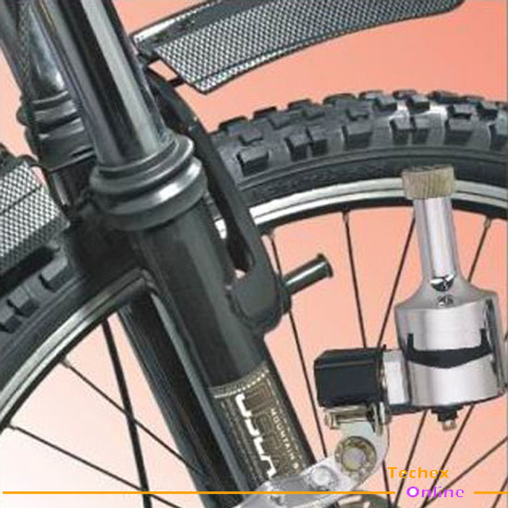
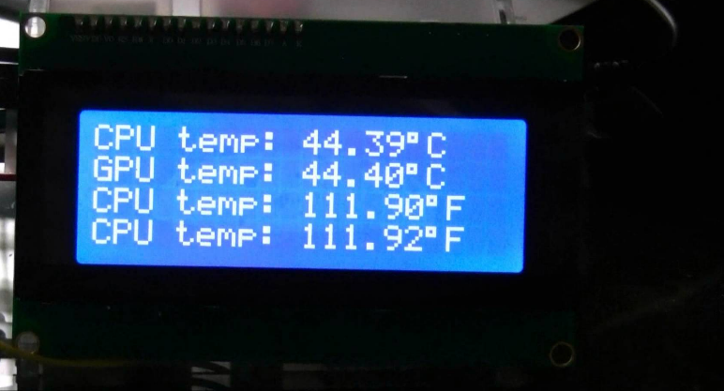
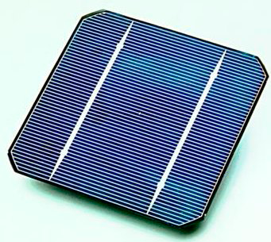
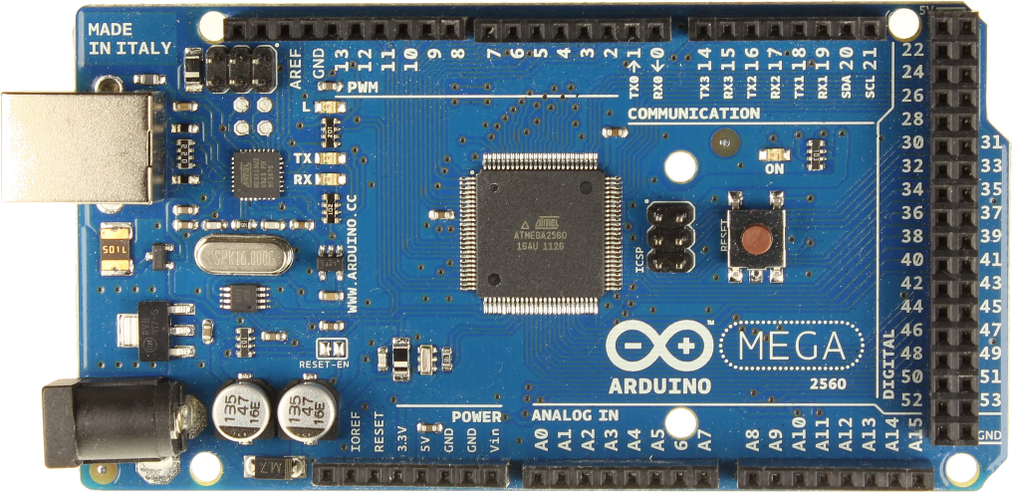
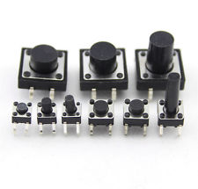
4
Requirements
Heating Element
Cooling Element
User Interface
Renewable energy sources
Microcontroller/Microprocessor
Battery
Mechatronics Project
School of Mechatronics

Slide 3
4
System Flow (Schematic)
Driver (Power Amplifier)
Peltier
Cost efficient design
Driver (Power Amplifier)
Heating Wire
Buttons
Arduino
LCD (20x4)
Dynamo (Generator)
Battery
Power Part
User
interface
Solar Cell
User can’t interact
Mechatronics Project
School of Mechatronics

Slide 4
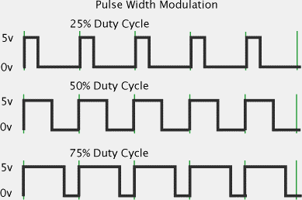

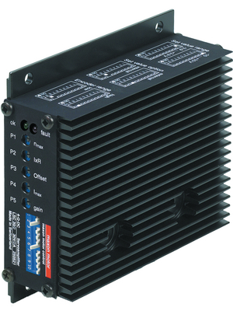
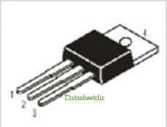
4
Components
Paltier
Thermoelectric materials
Seebeck effect (converting temperature to current)
Peltier effect (converting current to temperature)
Heating Coil
Very low efficiency of Paltier
Heating wire is optimal solution
Drivers (Power Amplifiers)
Using MOSFETs for cost efficiency
Arduino Microcontroller
Mechatronics Project
School of Mechatronics

Slide 5
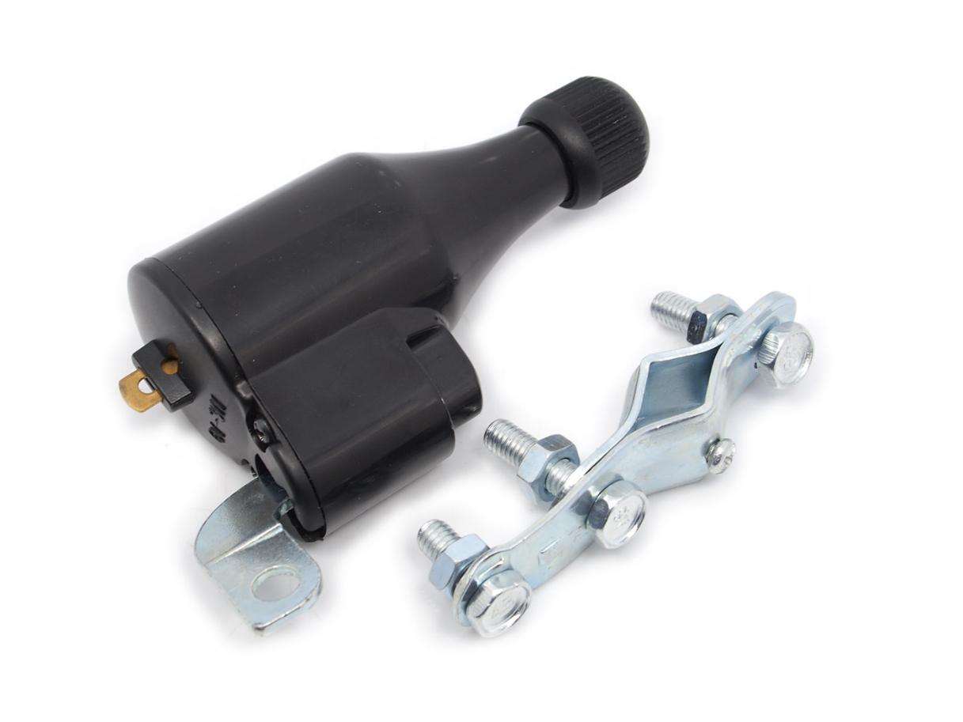
4
Components
LCD
20x4 LCD
Not only temp. display!
Battery
High current portable rechargeable battery
Solar Cell
6W (x2) solar cell
Dynamo (Generator)
6W (x2) dynamo
Mechatronics Project
School of Mechatronics

